Slide 1

KAVALKARAN
Id : 1123742 , group: kavalkaran_team_cyber_security
Them : Good Governance and Public service delivary
(Athul vinod .M) Contact : Phone – 9539218900 , mail : athul.back.is.now@gmail.com
Institution : R.M.H.S.S Melattur
District : Malappuram

Slide 2

Problem statement
8.7 percentage of under teenagers dead by the suicide by the cyber bulling (Proof : Figure 3.0)
Cyber security is the one of the dangerous problem ever seen by the whole humans
1.12 Billions of cellular mobile connection have active in 2025 , That is the 76.6 of total people (Proof Attached in last figure 2.0)
In India 20,41,360 incidents reported at 2024 (Figure 1.0 [In the last])
We are trying to address the entire Cyber attacks which includes phishing, banking attacks, cyber fraud, spamming and much more with that a man lose his privacy and right to dignity, or any other right
This attacks make a large the flow which can lead to suicide or anything hard, hence this problem is even capable to lose the life of a human.

Slide 3
Idea Summary
My idea is to give a power full tool for common people which entirely developed for common people but no excuses in working and safety. Which I developed is a web tool with access of every one from anywhere , No download is compulsory.
(But optional), Which is now contains a url scanner to get safety checks of url before entering or check the safety , QR code checker to not predict but give direct info of that what happen by scan , is it safe and more , Also we provided a cyber doubts section and File Locker for securely encrypt and save files in browser any hacker can’t got it , but fully ready for its author or with his permission. There are more features in that digital sinario.
We are Not making the Attackers least ,
We are making the victims to defend there self to Attackers !

Slide 4





SOCIAL
Social
Benefiters
People across kerala who are using internet, Also IT experts for job opportunity
Unique
We are not doing that same mistake which thinks only about awareness. We are giving real world tools designed and crafted for common people but with also awareness. Our tools can be used by the common people them self and find what to do and what is happening without help of no one and time delay 100% proven way
Anyone proposed same Solution
In the internet third party tools are available but that is uses complex language hard to understand even It professional ,Most of them are fake , Every tools are on another and another platforms so hard to reach and know but we created every thing in one place
Is we implimented
We are implemented free version. In https://kavalkaran.github.io/redict
Public opensource code in Github

Slide 5
PROJECT STATUS
Now the free version with all the
features is available but we
are not ready stop the development
the paid version is coming and
capable to launch In 1 or 2 months

Slide 6
Voice of Stakeholder Survey
Stakeholder
Common people In kerala , IT experts ,
Google form - survey
We are conducted a google form survey after launching the free version in internet (Document )
Expert feedbacks
We collected feedback from an Ethical Hacker about this idea – Name can’t be revealable. He says the translation is needed for Non-kerala users and Tech experts. (We will definitally do that)

Slide 7
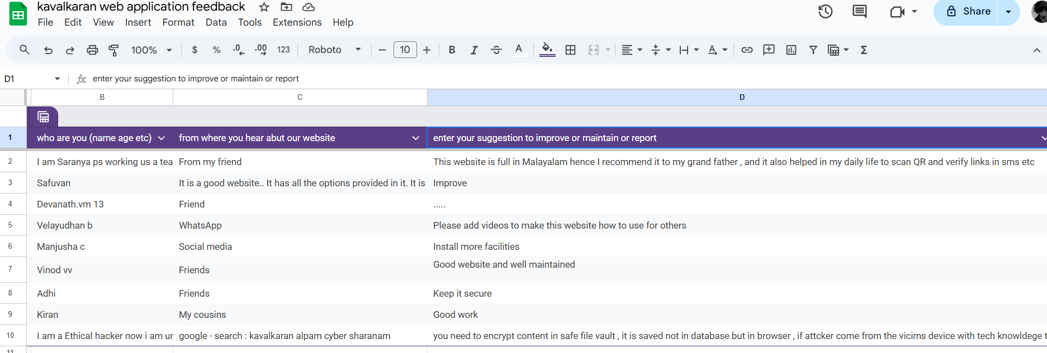
Source : Google spread sheet + Google form

Slide 8
Competitors
Competitors
There are now so much online tools in English but only widely used by hackers
Differents between competitors
They are all of them In English, Most of there are using complex technical words lead to misunderstanding for common people there paid plans are too costly.
We are expecting in a low cost
Niche area
Our solution strengthens Good Governance and Public Service Delivery by empowering citizens to stay safe online. As digital governance grows, our cyber security tool protects people from fraud, data theft, and scams—building trust, safety, and confidence in public digital services.
What is your niche area?
Our niche area is Good Governance and Public Service Delivery.
We focus on enhancing digital safety and trust in governance by developing a cyber security tool for common citizens. The project aims to make public digital platforms more secure and accessible, ensuring that every citizen can confidently use e-Governance and online public services without fear of cyber threats.

Slide 9
Tech Stack used
Html
css
js
Python (flask)
API
Basically needed to create a website
Styling and be user friendly
For front end logic
Back end systems,
Authentication etc.
(paid only)
Using open source Api

Slide 10
Investment/Support needed
SL no. | What is the fund required for | When it required | What is the amount required | How do we measure the outcome of the fund disbursed
1 | Web source code building and engansing (One time investment) | First stage | 50,000 | Check the code is working done
2 | Hosting + Domain charges | Release | {Average 1500 Rs according to current domain rate } | Check the domain displays our website
3 | Social media ads + email marketing | Marketing | INR 1,00,000 | Check the traffic of website, ads dashboard, mail replays
4 | Updations & maintain | Maintain | {According to the Profit } | Is tool have the right working according to the updation plan

Slide 11
Project Schedule
SL no. | Phase | Activity | How to know if task is completed ? | Fund required (Insert from serial number)
1 | Source code Development | Develop the Website | Check it is working well for requirments | 1
2 | Hosting in internet | Host it in the internet and make this accessable for every one | Check is it in the specific Domain we expected | 2
3 | Marketing strategy and testing | Creating ads posting it , Promotions from Tech companys email marketting | Check the current website traffic is it increased like our expectation so done | 3
4 | Project maintain | Update existing things , analyse voice of customer | Hacker updates endless because of new tech , so we also needed to update | 4

Slide 12
Impact
Out come appear
Cyber attacks may happen like now but victims are entirely power full and there is a only a small part of people only be damaged throw cyber attack, Most of the people handle problem their own if smaller
Our solution make money
We introduce paid and free plan to the users those need and focus on high level privacy by taking premium needed to pay the money to us.It also earn form donations , Ads by its real world skills
Solution benefit society
We offer paid and free plan if a person have not enough cash to spent then can be they use affordable version , the paid plan have a low cost under 200 and larger than 50
Business Impact
Profit will be increase because there is no Malayalm tools to help them in cyber security. People will give first priority to data so they definitely use this may be use the premium because it is affordable
Social Impact
This will create a large impact by we offer free plan , and also we offer premium with very low cost throw that is really giving a opportunity even for a revolutionary movement

Slide 13
Support Expected from Yip
We Expected from Yip
We are expecting the fund for the project which secure the entire cyber world.
Can the Yip turn this into a government-backed project — a revolutionary movement where the government develops a powerful cybersecurity tool to protect its people, create jobs for ethical hackers and software developers, provide income opportunities, and promote social welfare? This would make it a ‘by the people, for the people’ initiative in national cybersecurity.

Slide 14
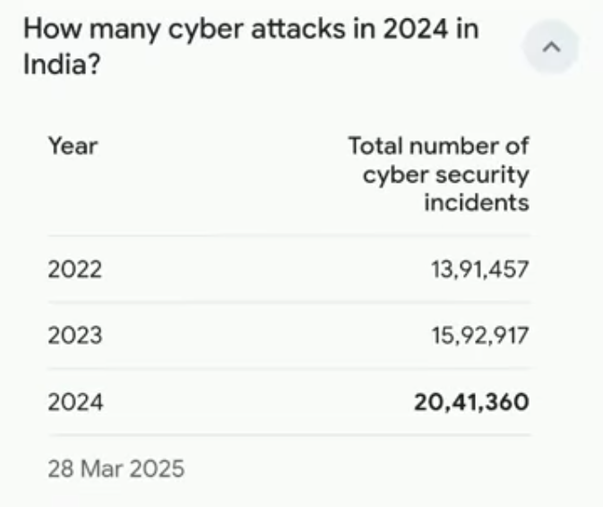
Figure 1.0
SOURCE : google.com

Slide 15
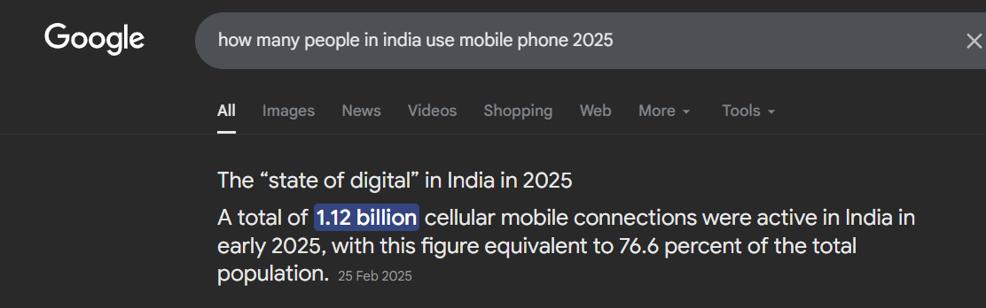
Figure 2.0
Source : Google.com

Slide 16
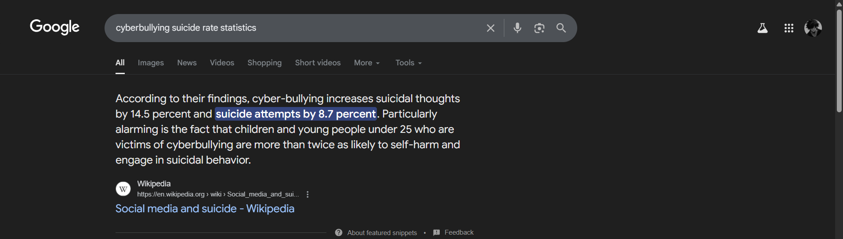
Source : Google.com
Figure 3.0

Slide 17
Athul vinod .M
Devanath V.M
Full stack web developer
Listed by the google searches
Cyber security student (Self learning)
I am a
Python flask developer
Frontend developer
Knows variant tools like Git, Microservices etc.
Online researcher
Non technical supporter

Slide 18
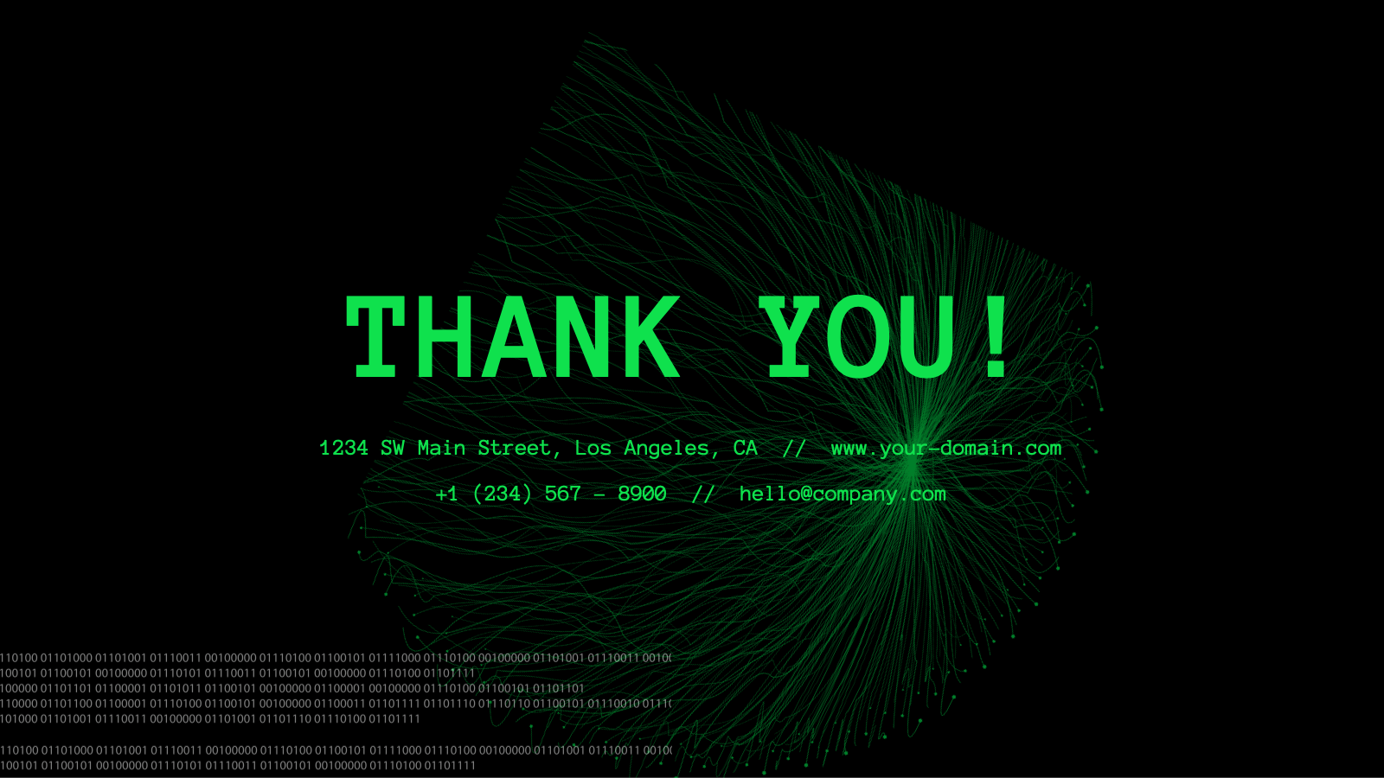
Thank you
_____________________________________________________________________
+91 9539218900
Kavalkaran.github.io/redict
We are Not making the Attackers least , We are making the victims to defend there self to Attackers !

